Slide 1


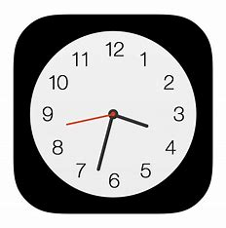



Setting
Camera
Clock
HEALHUB
Safari
Gallery
HealHub

Slide 2
LOADING …

Slide 3

Welcome back, xxx
What can I help you today
8
Self heal resource
Quick personality
assessment
Experienced
peers support
chat
Anonymous
24/7 online virtual support

Slide 4
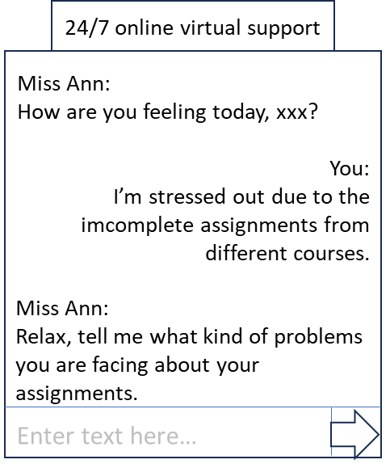
Welcome back, xxx
What can I help you today
8
Self heal resource
Quick personality
assessment
Meet
the
peers
chat
Anonymous
experience
End
conversation

Slide 5

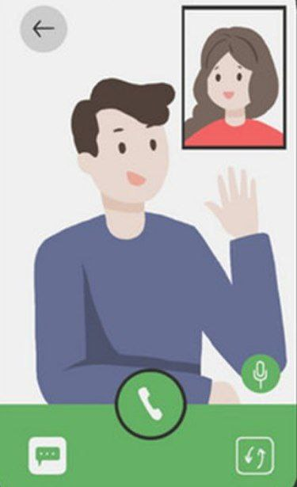
Return

Slide 6
Return
Quick personality assessment
1. Strongly disagree 2. Disagree
3. Agree 4. Strongly agree
I couldn't seem to experience any positive feeling at all
I experienced breathing difficulty
I tended to over-react to situations
I experienced trembling
I felt that I was using a lot of nervous energy
I felt that I had nothing to look forward to
I found difficult to relax
I felt I was close to panic
I felt I wasn't worth much as a person
1. 2. 3. 4.
1. 2. 3. 4.
1. 2. 3. 4.
1. 2. 3. 4.
1. 2. 3. 4.
1. 2. 3. 4.
1. 2. 3. 4.
1. 2. 3. 4.
1. 2. 3. 4.
Submit

Slide 7
Return
Quick personality assessment
Your may have mental health condition of:
{ Anxiety disorder}
What is anxiety:
people with anxiety disorders frequently have intense, excessive and persistent worry and fear about everyday situations
These feelings of anxiety and panic interfere with daily activities, are difficult to control, are out of proportion to the actual danger and can last a long time
Suggestion:
Meet the cured anxiety disorder patient who would like to share their ways in get rid of anxiety disorders.
Watch the video below to get more information and some simple way to cure your anxiety disorder,

Slide 8

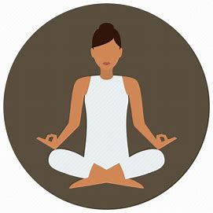



Return
Self heal resource
Read some relaxing article that might heal you
Do a quick 10 minutes meditation
Play some mini game to calm yourself down
Watch some funny and joyful video
Listen to calm and relaxing music

Slide 9
Return
Self heal resource
In the hustle and bustle of our daily lives, finding moments of tranquillity can be a powerful antidote to the stresses that weigh on our minds. Amidst the chaos, it's crucial to carve out spaces for mental healing and rejuvenation.
One of the simplest yet profoundly effective methods to soothe the mind is through mindful breathing. Take a few minutes each day to sit in a quiet space, close your eyes, and focus on your breath. Inhale deeply, feeling the air fill your lungs, and exhale slowly, releasing any tension. This practice not only calms the nervous system but also brings your attention to the present moment, away from the worries of the past or the uncertainties of the future.

Slide 10
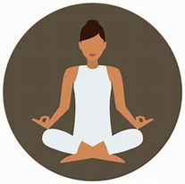
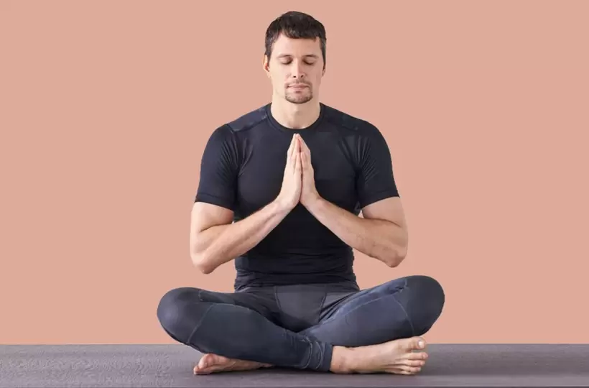

Return
Self heal resource

Slide 11

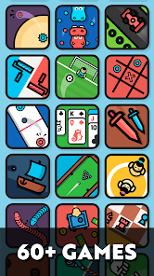
Return
Self heal resource

Slide 12

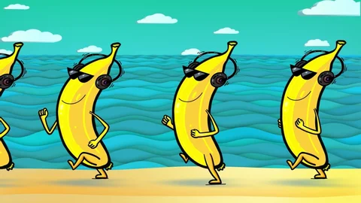

Return
Self heal resource

Slide 13

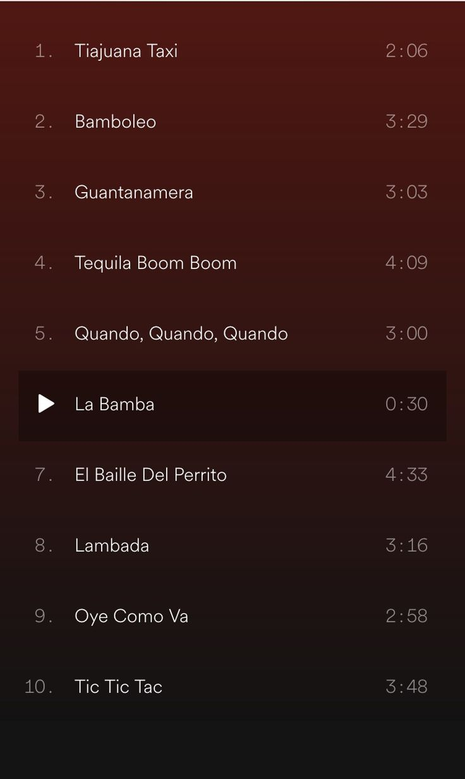
Return
Self heal resource

Slide 14

Anonymous chat
Return
12/12/2022 11:08 PM
Write your post anonymously
Anyone has an idea how to overcome insomnia. I have been suffered from insomnia for 1 week.
8/12/2022
08:57 PM
I have no friends to play game with. Is there anyone willing to play Valorant with me?
Anonymous 1:
I think avoid using electronic gadgets before…
7/12/2022 8:30 AM
Anonymous 1:
Of course! My id is 0123, feel free to play with me
Good morning everyone. Hope all of you are having a great day
Anonymous 2:

Slide 15
Meet the experience peers
Return
Meet Tan Xiao Ming
A cured person with post-traumatic stress disorder (PTSD) is here to share the progress of how he is able to cure his mental health disorder..
Meet Ahmad Daniel bin Mustafa
A depression university students who had solved his depression with the help of friend and finding himself a hobby.
Meet Suria a/p Murugan
A girl who has low self-esteem and causing her to have anxiety and autism disorders but she …

